Slide 1

A Project on Movie and TV Series Recommendation System
Devin Lim, Maelice Yamdjieu, Oliver Xing, Shiva Skandhan, Tejaswi Neelapu

Slide 2
Problem Summary
Too many streaming services
Shows exclusive to specific services
Spreadsheets are not user friendly

Slide 3
Solution: MTVSRS
Movie and TV Series Recommendation System is a stand-alone offering that can be used with any streaming service.
Users are able to track their watch history and be provided with individualized and varied recommendations.
Enhanced content discoverability and user satisfaction

Slide 4
MTVSRS: Mission Statement
Boost content discoverability for improved user satisfaction.
Ensure compatibility with streaming services
Analyse user behavior for personalized content suggestions.
Create a seamless and intuitive experience for users.

Slide 5
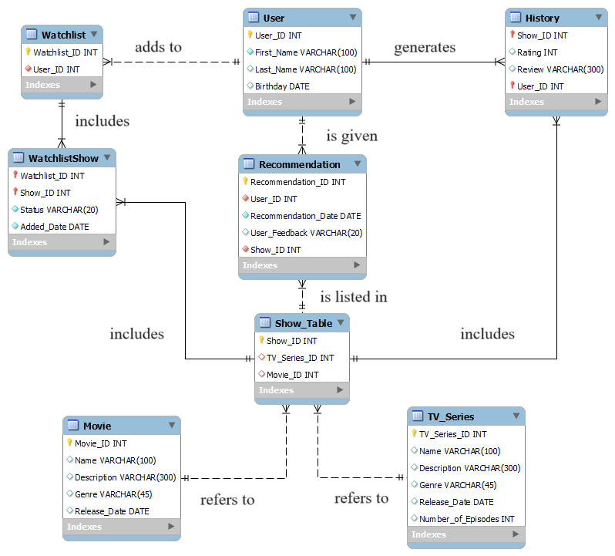
User:
Create an Account
Add to Watchlist
Planned
Watching
Completed
Dropped
Provide Reviews and Ratings
MTVSRS:
Display show data
Display user watchlist
Display reviews and ratings
Provide Recommendations

Slide 6
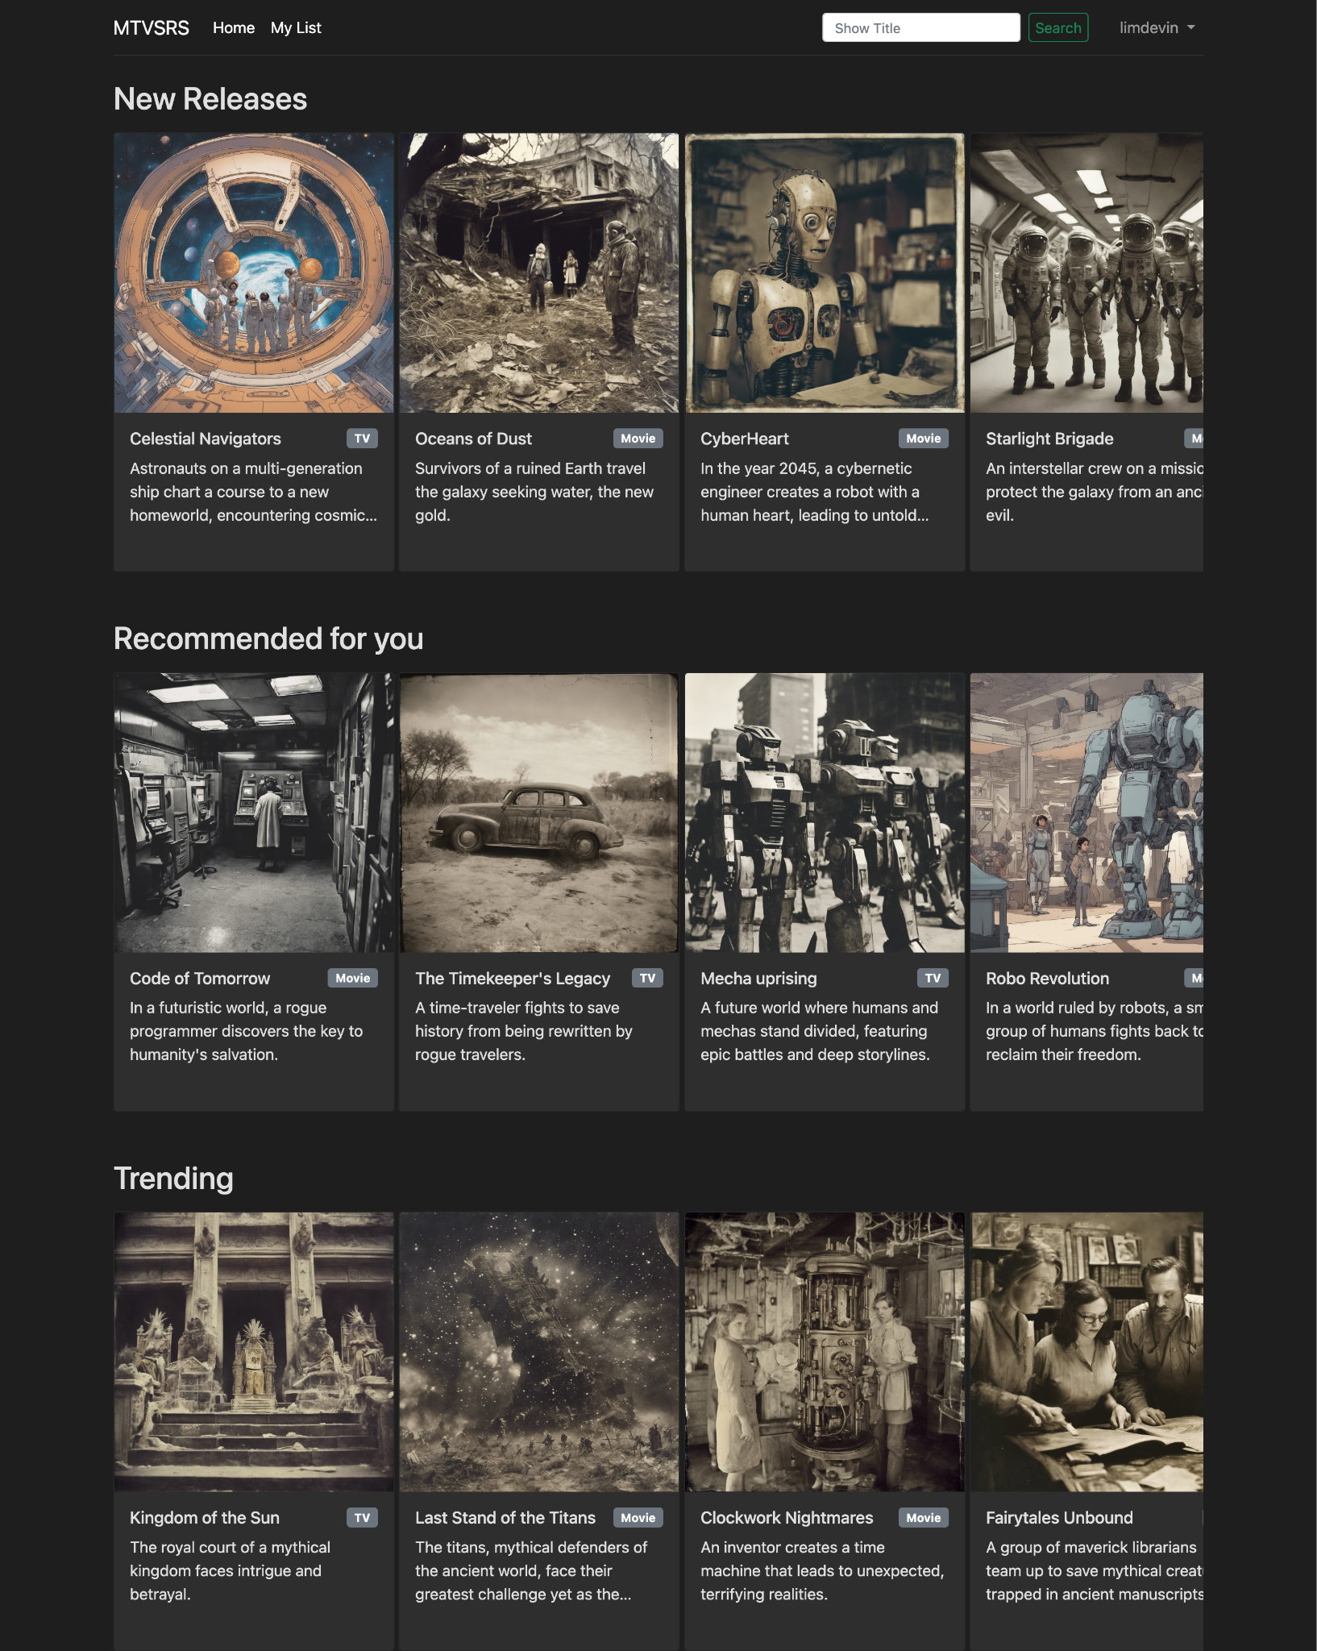
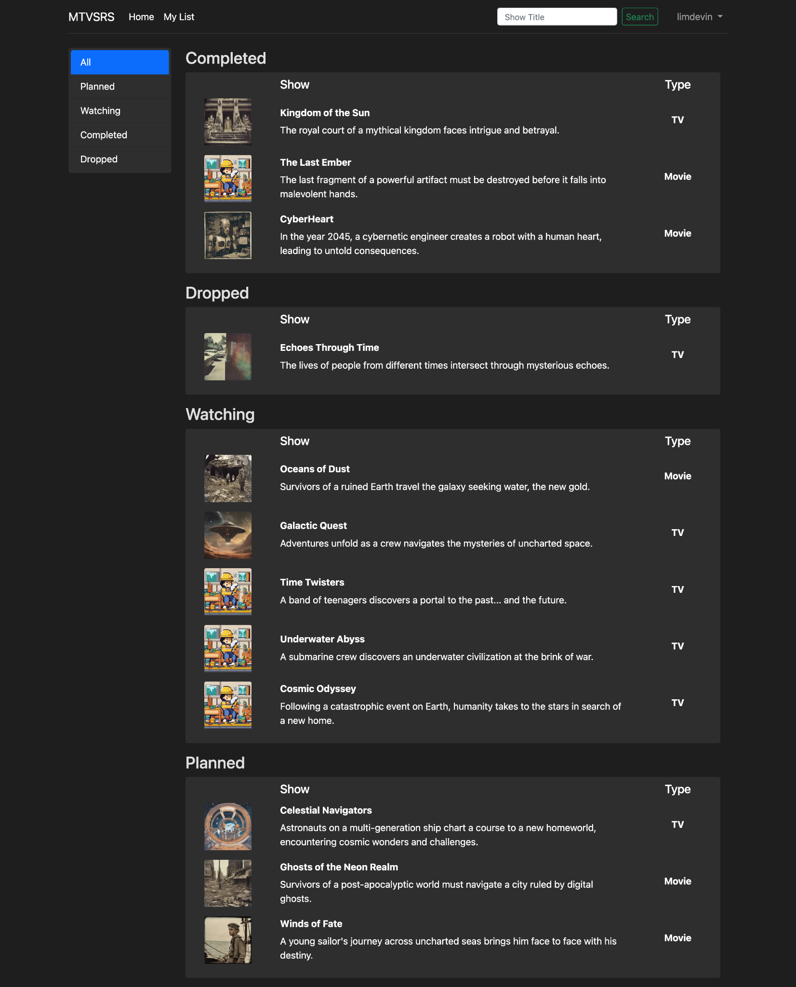
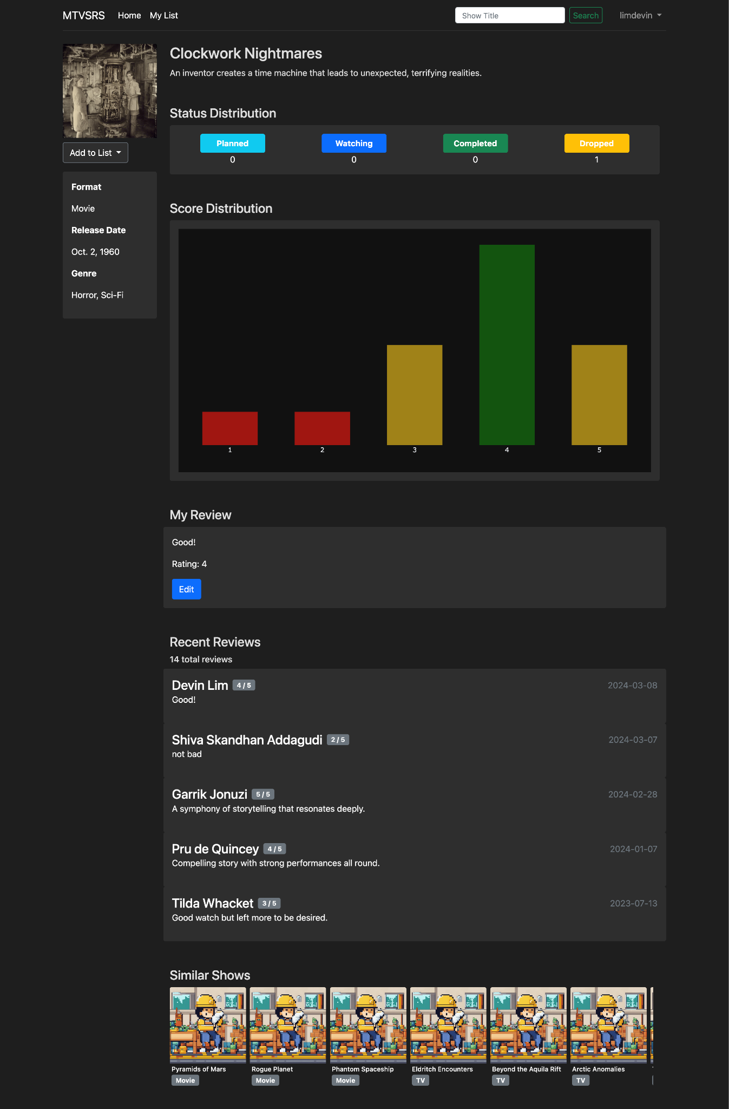
Sneak Peek

Slide 7
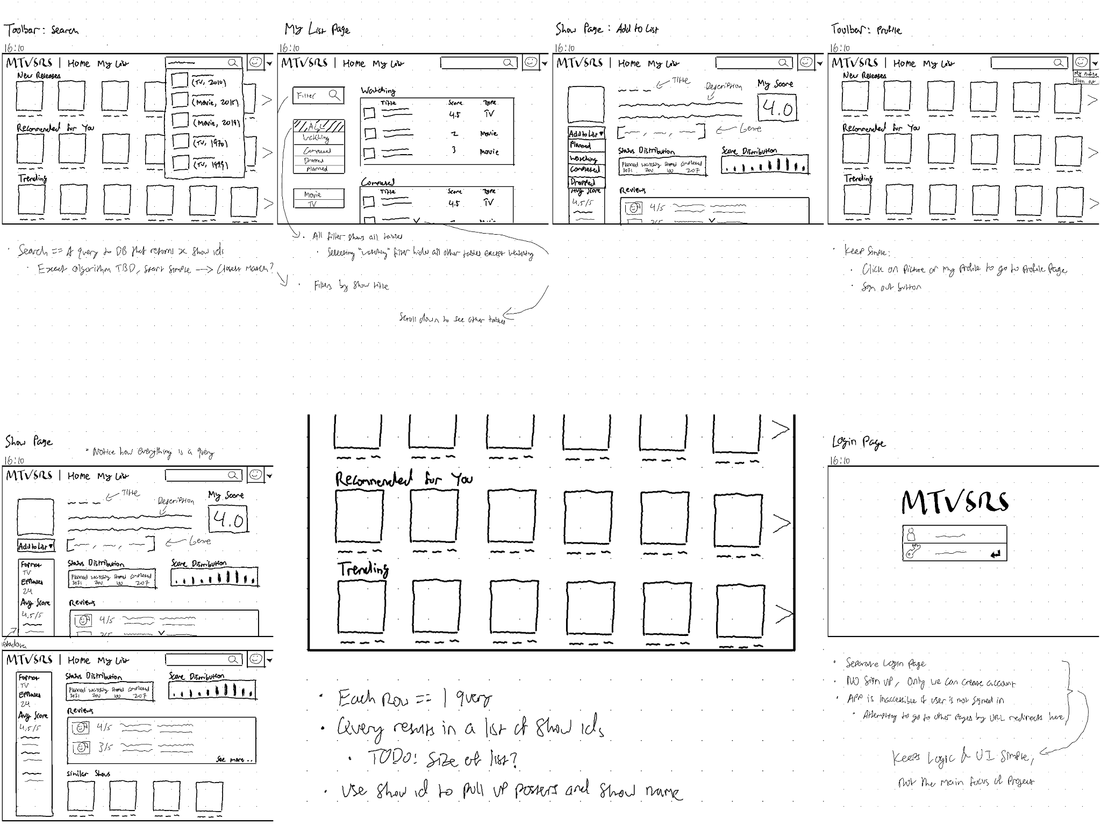
Design

Slide 8









Technologies
App
github.com/CPSC5071/mtvsrs
Hosting
Data Generation
github.com/CPSC5071/mockagpt
github.com/CPSC5071/composite_key_generator

Slide 9
App Demo
http://3.85.11.137/
Try it yourself!

Slide 10
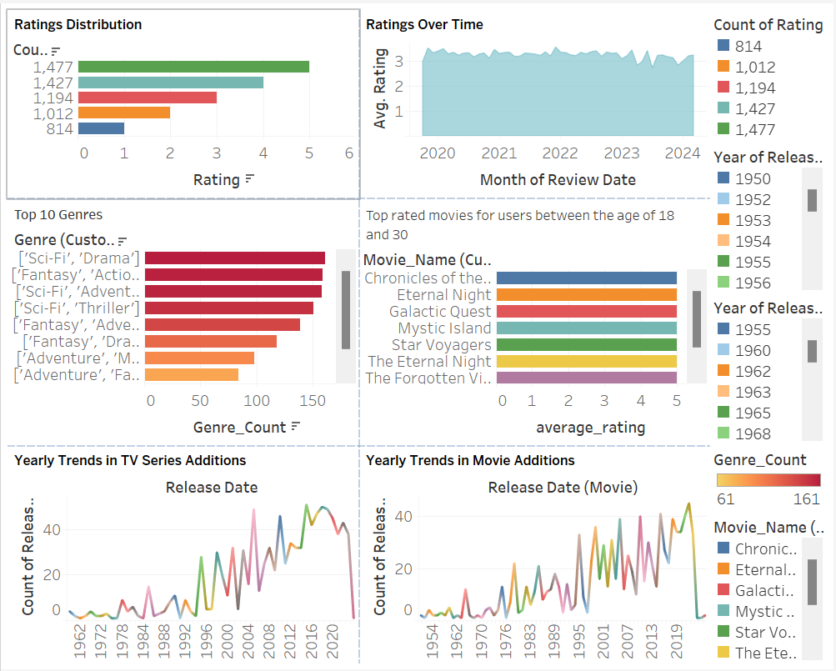
Tableau

Slide 11
Key Takeaways
Simplify the streaming experience for users overwhelmed by multiple platforms.
System uses behaviour analysis to offer personalized recommendations.
Users can access their favorite content across various platforms.
Watchlist management, ratings and reviews encourage user satisfaction.
Overall, MTVSRS ensures user engagement and satisfaction.

Slide 12

Q&A THANK YOU!

